Slide 1
SECV – Tobias Weis
RoboCup – Camera stuff

Slide 2
TOC
Camera & sensor hardware
Parameters
1

Slide 3
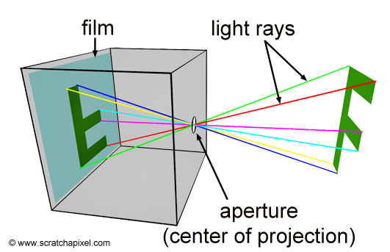
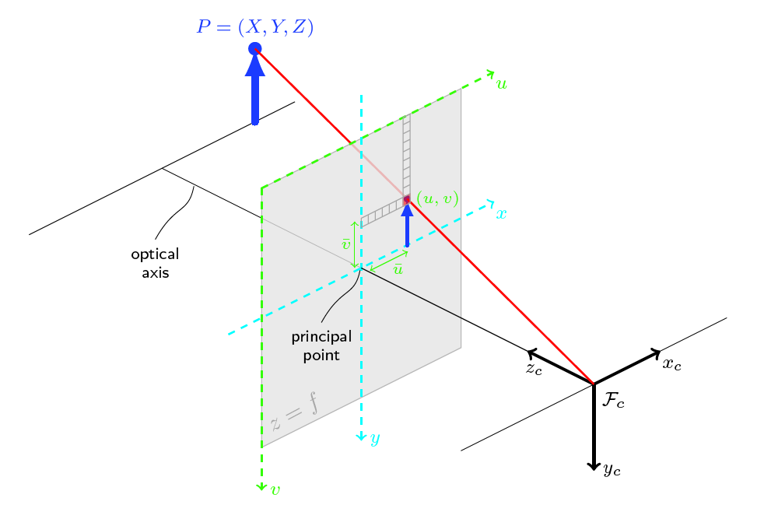
Camera parameters & effects
Camera hardware
https://www.scratchapixel.com/lessons/3d-basic-rendering/3d-viewing-pinhole-camera
http://docs.opencv.org/2.4/modules/calib3d/doc/camera_calibration_and_3d_reconstruction.html
1

Slide 4
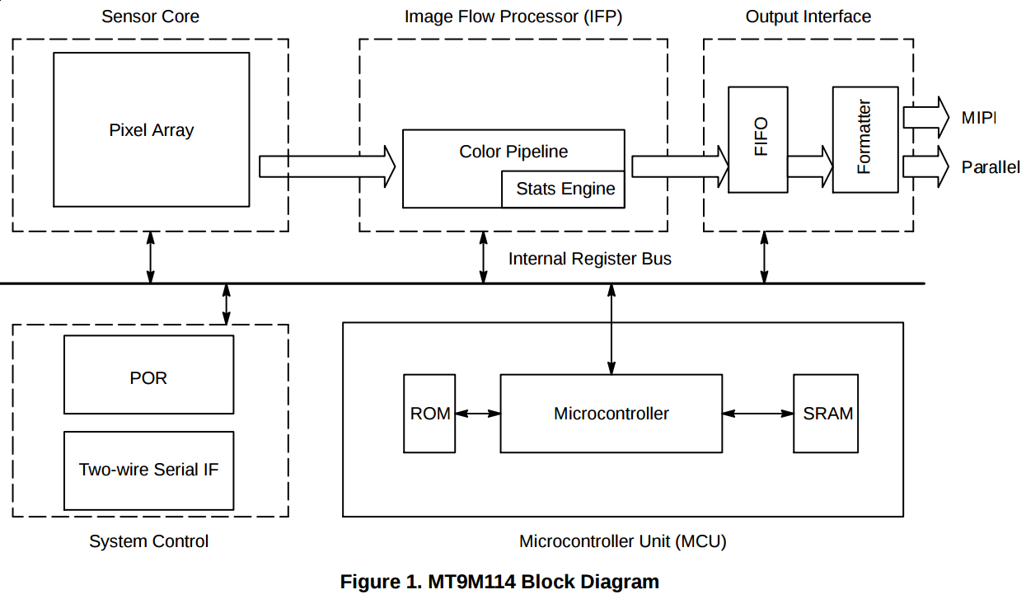
Camera parameters & effects
Camera | Model | MT9M114
 | Type | SOC Image Sensor
Imaging Array | Resolution | 1.22 Mp
 | Optical format | 1/6 inch
 | Active Pixels (HxV) | 1288x968
Sensitivity | Pixel size | 1.9µm*1.9µm
 | Dynamic range | 70 dB
 | Signal/Noise ratio (max) | 37dB
 | Responsivity | 2.24V/Lux-sec (550 nm)
Output | Camera output | 1280*960@30fps
 | Data Format | (YUV422 color space)
 | Shutter type | Electronic Rolling shutter
View | Field of view | 72.6°DFOV
 | Focus range | 30cm ~ infinity
 | Focus type | Fixed focus
Nao camera hardware - meaning
http://www.onsemi.com/pub_link/Collateral/MT9M114-D.PDF
1

Slide 5
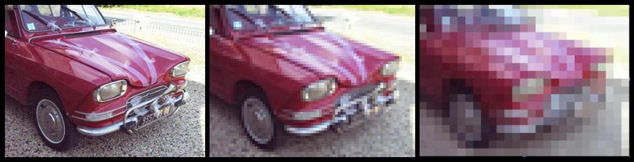
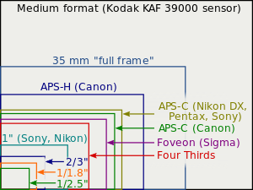
Camera parameters & effects
Camera | Model | MT9M114
 | Type | SOC Image Sensor
Imaging Array | Resolution | 1.22 Mp
 | Optical format | 1/6 inch
 | Active Pixels (HxV) | 1288x968
Sensitivity | Pixel size | 1.9µm*1.9µm
 | Dynamic range | 70 dB
 | Signal/Noise ratio (max) | 37dB
 | Responsivity | 2.24V/Lux-sec (550 nm)
Output | Camera output | 1280*960@30fps
 | Data Format | (YUV422 color space)
 | Shutter type | Electronic Rolling shutter
View | Field of view | 72.6°DFOV
 | Focus range | 30cm ~ infinity
 | Focus type | Fixed focus
Nao camera hardware - meaning
https://upload.wikimedia.org/wikipedia/commons/3/32/Resolution_test.jpg
https://en.wikipedia.org/wiki/Image_sensor_format
1

Slide 6
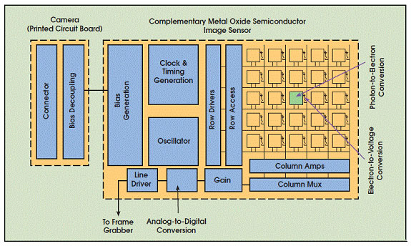
Camera parameters & effects
Camera | Model | MT9M114
 | Type | SOC Image Sensor
Imaging Array | Resolution | 1.22 Mp
 | Optical format | 1/6 inch
 | Active Pixels (HxV) | 1288x968
Sensitivity | Pixel size | 1.9µm*1.9µm
 | Dynamic range | 70 dB
 | Signal/Noise ratio (max) | 37dB
 | Responsivity | 2.24V/Lux-sec (550 nm)
Output | Camera output | 1280*960@30fps
 | Data Format | (YUV422 color space)
 | Shutter type | Electronic Rolling shutter
View | Field of view | 72.6°DFOV
 | Focus range | 30cm ~ infinity
 | Focus type | Fixed focus
Nao camera hardware – meaning
CMOS technology:
Electron-to-Voltage conversion IN PIXEL:
Effective sensing area smaller (than CCD)
due to other needed electronics
Less blooming/bleeding than CCD
https://www.tedpella.com/cameras_html/ccd_cmos.htm
1

Slide 7
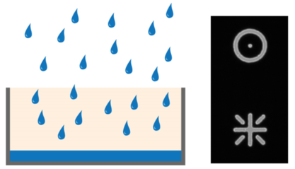
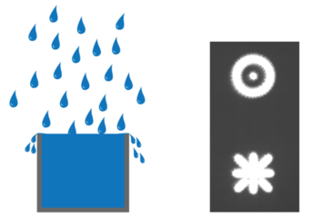
Camera parameters & effects
Camera | Model | MT9M114
 | Type | SOC Image Sensor
Imaging Array | Resolution | 1.22 Mp
 | Optical format | 1/6 inch
 | Active Pixels (HxV) | 1288x968
Sensitivity | Pixel size | 1.9µm*1.9µm
 | Dynamic range | 70 dB
 | Signal/Noise ratio (max) | 37dB
 | Responsivity | 2.24V/Lux-sec (550 nm)
Output | Camera output | 1280*960@30fps
 | Data Format | (YUV422 color space)
 | Shutter type | Electronic Rolling shutter
View | Field of view | 72.6°DFOV
 | Focus range | 30cm ~ infinity
 | Focus type | Fixed focus
Nao camera hardware – meaning
Pixels – Full-well capacity
Blooming artifacts & oversaturation are a function
of pixel-size
http://www.leica-microsystems.com/science-lab/microscope-cameras/introduction-to-digital-camera-technology/
1

Slide 8
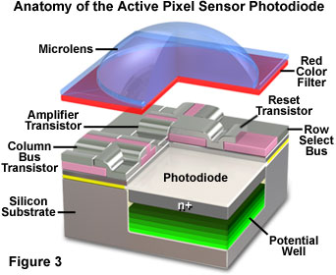
Camera parameters & effects
Camera | Model | MT9M114
 | Type | SOC Image Sensor
Imaging Array | Resolution | 1.22 Mp
 | Optical format | 1/6 inch
 | Active Pixels (HxV) | 1288x968
Sensitivity | Pixel size | 1.9µm*1.9µm
 | Dynamic range | 70 dB
 | Signal/Noise ratio (max) | 37dB
 | Responsivity | 2.24V/Lux-sec (550 nm)
Output | Camera output | 1280*960@30fps
 | Data Format | (YUV422 color space)
 | Shutter type | Electronic Rolling shutter
View | Field of view | 72.6°DFOV
 | Focus range | 30cm ~ infinity
 | Focus type | Fixed focus
Nao camera hardware - meaning
http://olympus.magnet.fsu.edu/primer/digitalimaging/cmosimagesensors.html
1

Slide 9
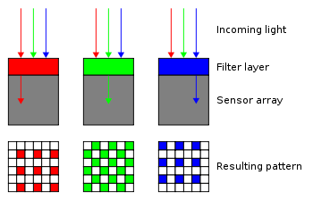
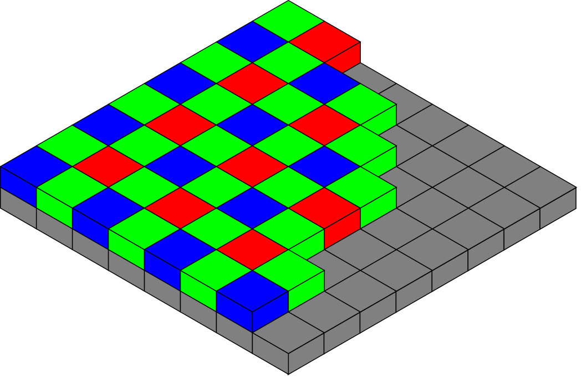
Camera parameters & effects
Camera | Model | MT9M114
 | Type | SOC Image Sensor
Imaging Array | Resolution | 1.22 Mp
 | Optical format | 1/6 inch
 | Active Pixels (HxV) | 1288x968
Sensitivity | Pixel size | 1.9µm*1.9µm
 | Dynamic range | 70 dB
 | Signal/Noise ratio (max) | 37dB
 | Responsivity | 2.24V/Lux-sec (550 nm)
Output | Camera output | 1280*960@30fps
 | Data Format | (YUV422 color space)
 | Shutter type | Electronic Rolling shutter
View | Field of view | 72.6°DFOV
 | Focus range | 30cm ~ infinity
 | Focus type | Fixed focus
Nao camera hardware – meaning
Bayer-Filter:
Twice as many green (luminance-sensitive) as
red and blue (chrominance-sensitive)
Mimic physiology of human eye
De-Mosaicing for final image, e.g. interpolation
Can cause artifacts at fine details (e.g. Moiré)
https://en.wikipedia.org/wiki/Bayer_filter
1

Slide 10
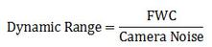
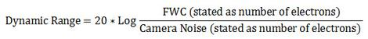
Camera parameters & effects
Camera | Model | MT9M114
 | Type | SOC Image Sensor
Imaging Array | Resolution | 1.22 Mp
 | Optical format | 1/6 inch
 | Active Pixels (HxV) | 1288x968
Sensitivity | Pixel size | 1.9µm*1.9µm
 | Dynamic range | 70 dB
 | Signal/Noise ratio (max) | 37dB
 | Responsivity | 2.24V/Lux-sec (550 nm)
Output | Camera output | 1280*960@30fps
 | Data Format | (YUV422 color space)
 | Shutter type | Electronic Rolling shutter
View | Field of view | 72.6°DFOV
 | Focus range | 30cm ~ infinity
 | Focus type | Fixed focus
Nao camera hardware – meaning
The sensor’s ability to simultaneously record
low and high intensity signals
In decibels:
1

Slide 11
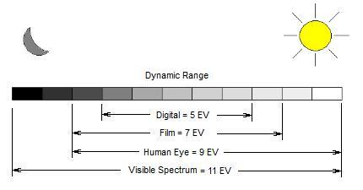
Camera parameters & effects
Camera | Model | MT9M114
 | Type | SOC Image Sensor
Imaging Array | Resolution | 1.22 Mp
 | Optical format | 1/6 inch
 | Active Pixels (HxV) | 1288x968
Sensitivity | Pixel size | 1.9µm*1.9µm
 | Dynamic range | 70 dB
 | Signal/Noise ratio (max) | 37dB
 | Responsivity | 2.24V/Lux-sec (550 nm)
Output | Camera output | 1280*960@30fps
 | Data Format | (YUV422 color space)
 | Shutter type | Electronic Rolling shutter
View | Field of view | 72.6°DFOV
 | Focus range | 30cm ~ infinity
 | Focus type | Fixed focus
Nao camera hardware – meaning
http://www.althephoto.com/concepts/spectrum.jpg
1

Slide 12
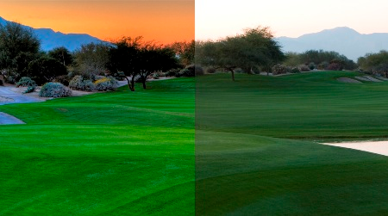
Camera parameters & effects
Camera | Model | MT9M114
 | Type | SOC Image Sensor
Imaging Array | Resolution | 1.22 Mp
 | Optical format | 1/6 inch
 | Active Pixels (HxV) | 1288x968
Sensitivity | Pixel size | 1.9µm*1.9µm
 | Dynamic range | 70 dB
 | Signal/Noise ratio (max) | 37dB
 | Responsivity | 2.24V/Lux-sec (550 nm)
Output | Camera output | 1280*960@30fps
 | Data Format | (YUV422 color space)
 | Shutter type | Electronic Rolling shutter
View | Field of view | 72.6°DFOV
 | Focus range | 30cm ~ infinity
 | Focus type | Fixed focus
Nao camera hardware – meaning
http://photographystepbystep.com/wp-content/uploads/2011/02/Dynamic-Range.jpg
1

Slide 13
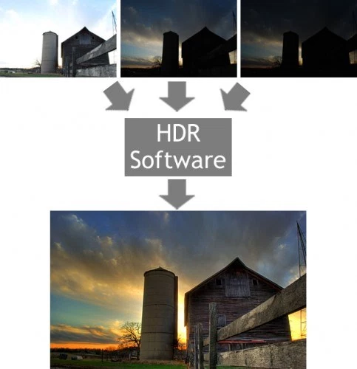
Camera parameters & effects
Camera | Model | MT9M114
 | Type | SOC Image Sensor
Imaging Array | Resolution | 1.22 Mp
 | Optical format | 1/6 inch
 | Active Pixels (HxV) | 1288x968
Sensitivity | Pixel size | 1.9µm*1.9µm
 | Dynamic range | 70 dB
 | Signal/Noise ratio (max) | 37dB
 | Responsivity | 2.24V/Lux-sec (550 nm)
Output | Camera output | 1280*960@30fps
 | Data Format | (YUV422 color space)
 | Shutter type | Electronic Rolling shutter
View | Field of view | 72.6°DFOV
 | Focus range | 30cm ~ infinity
 | Focus type | Fixed focus
Nao camera hardware – meaning
http://i0.wp.com/www.digicamhelp.com/site/wp-content/uploads/2009/06/hdr-demo.jpg
1

Slide 14
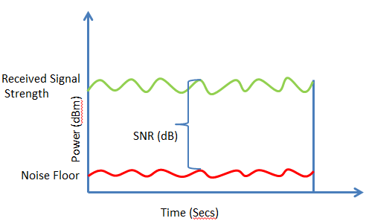
Camera parameters & effects
Camera | Model | MT9M114
 | Type | SOC Image Sensor
Imaging Array | Resolution | 1.22 Mp
 | Optical format | 1/6 inch
 | Active Pixels (HxV) | 1288x968
Sensitivity | Pixel size | 1.9µm*1.9µm
 | Dynamic range | 70 dB
 | Signal/Noise ratio (max) | 37dB
 | Responsivity | 2.24V/Lux-sec (550 nm)
Output | Camera output | 1280*960@30fps
 | Data Format | (YUV422 color space)
 | Shutter type | Electronic Rolling shutter
View | Field of view | 72.6°DFOV
 | Focus range | 30cm ~ infinity
 | Focus type | Fixed focus
Nao camera hardware – meaning
Noise sources
Dark noise (current): thermal energy
(electrons per pixel per second)
Read noise (Quantification noise in A2D)
Photon shot noise (uncertainty in counting photons
due to stochastic nature of photon impacts)
https://documentation.meraki.com/MR/WiFi_Basics_and_Best_Practices/Wireless_fundamentals%3A_Signal-to-Noise_Ratio_(SNR)__and_wireless_signal_strength
1

Slide 15
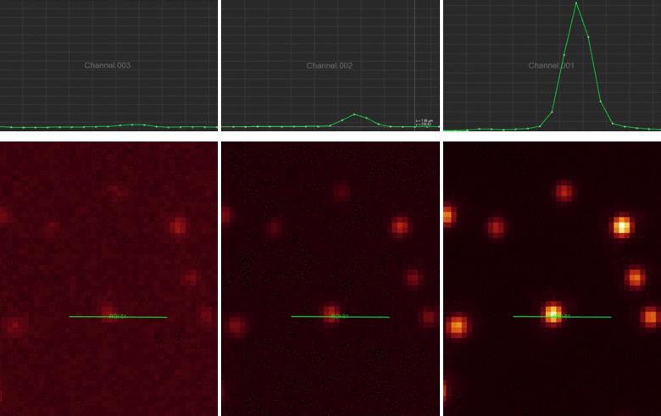
Camera parameters & effects
Camera | Model | MT9M114
 | Type | SOC Image Sensor
Imaging Array | Resolution | 1.22 Mp
 | Optical format | 1/6 inch
 | Active Pixels (HxV) | 1288x968
Sensitivity | Pixel size | 1.9µm*1.9µm
 | Dynamic range | 70 dB
 | Signal/Noise ratio (max) | 37dB
 | Responsivity | 2.24V/Lux-sec (550 nm)
Output | Camera output | 1280*960@30fps
 | Data Format | (YUV422 color space)
 | Shutter type | Electronic Rolling shutter
View | Field of view | 72.6°DFOV
 | Focus range | 30cm ~ infinity
 | Focus type | Fixed focus
Nao camera hardware – meaning
http://www.leica-microsystems.com/science-lab/microscope-cameras/introduction-to-digital-camera-technology/
1

Slide 16
Camera parameters & effects
Camera | Model | MT9M114
 | Type | SOC Image Sensor
Imaging Array | Resolution | 1.22 Mp
 | Optical format | 1/6 inch
 | Active Pixels (HxV) | 1288x968
Sensitivity | Pixel size | 1.9µm*1.9µm
 | Dynamic range | 70 dB
 | Signal/Noise ratio (max) | 37dB
 | Responsivity | 2.24V/Lux-sec (550 nm)
Output | Camera output | 1280*960@30fps
 | Data Format | (YUV422 color space)
 | Shutter type | Electronic Rolling shutter
View | Field of view | 72.6°DFOV
 | Focus range | 30cm ~ infinity
 | Focus type | Fixed focus
Nao camera hardware – meaning
Responsivity:
input–output gain of a detector system:
electrical output per optical input
1

Slide 17
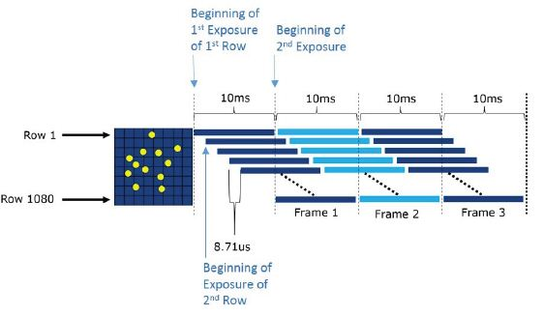
Camera parameters & effects
Camera | Model | MT9M114
 | Type | SOC Image Sensor
Imaging Array | Resolution | 1.22 Mp
 | Optical format | 1/6 inch
 | Active Pixels (HxV) | 1288x968
Sensitivity | Pixel size | 1.9µm*1.9µm
 | Dynamic range | 70 dB
 | Signal/Noise ratio (max) | 37dB
 | Responsivity | 2.24V/Lux-sec (550 nm)
Output | Camera output | 1280*960@30fps
 | Data Format | (YUV422 color space)
 | Shutter type | Electronic Rolling shutter
View | Field of view | 72.6°DFOV
 | Focus range | 30cm ~ infinity
 | Focus type | Fixed focus
Nao camera hardware – meaning
Rolling shutter
http://www.azom.com/images/Article_Images/ImageForArticle_12006(3).jpg
1

Slide 18
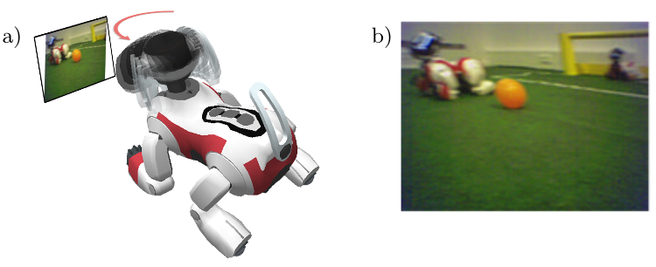
Camera parameters & effects
Camera | Model | MT9M114
 | Type | SOC Image Sensor
Imaging Array | Resolution | 1.22 Mp
 | Optical format | 1/6 inch
 | Active Pixels (HxV) | 1288x968
Sensitivity | Pixel size | 1.9µm*1.9µm
 | Dynamic range | 70 dB
 | Signal/Noise ratio (max) | 37dB
 | Responsivity | 2.24V/Lux-sec (550 nm)
Output | Camera output | 1280*960@30fps
 | Data Format | (YUV422 color space)
 | Shutter type | Electronic Rolling shutter
View | Field of view | 72.6°DFOV
 | Focus range | 30cm ~ infinity
 | Focus type | Fixed focus
Nao camera hardware – meaning
Rolling shutter
1

Slide 19
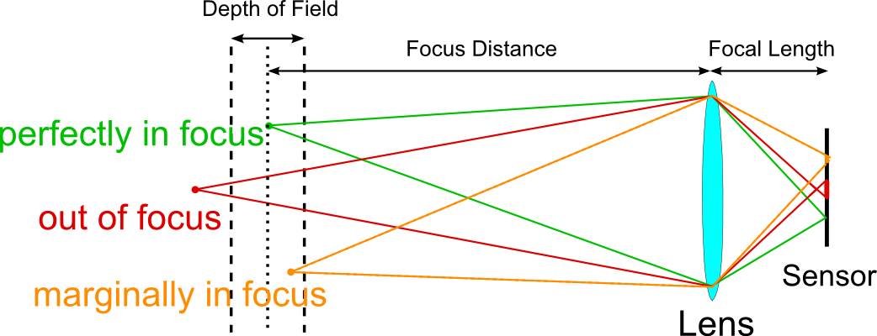
Camera parameters & effects
Camera | Model | MT9M114
 | Type | SOC Image Sensor
Imaging Array | Resolution | 1.22 Mp
 | Optical format | 1/6 inch
 | Active Pixels (HxV) | 1288x968
Sensitivity | Pixel size | 1.9µm*1.9µm
 | Dynamic range | 70 dB
 | Signal/Noise ratio (max) | 37dB
 | Responsivity | 2.24V/Lux-sec (550 nm)
Output | Camera output | 1280*960@30fps
 | Data Format | (YUV422 color space)
 | Shutter type | Electronic Rolling shutter
View | Field of view | 72.6°DFOV
 | Focus range | 30cm ~ infinity
 | Focus type | Fixed focus
Nao camera hardware – meaning
No focus control, preset by designer,
usually at a distance for which depth of field will
reach infinity even at the greatest aperture
possible with the lens.
https://cdn.photographylife.com/wp-content/uploads/2014/06/lens_dof.png
1

Slide 20
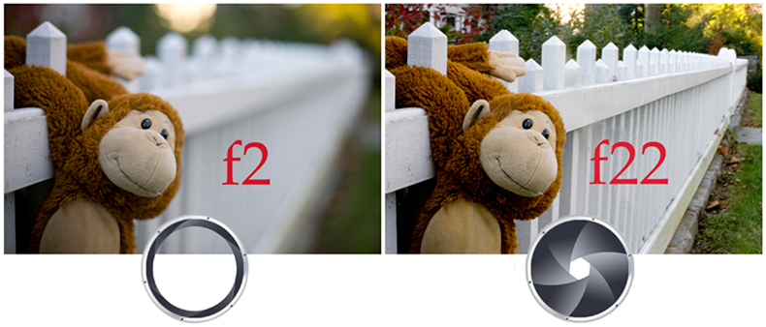
Camera parameters & effects
Camera | Model | MT9M114
 | Type | SOC Image Sensor
Imaging Array | Resolution | 1.22 Mp
 | Optical format | 1/6 inch
 | Active Pixels (HxV) | 1288x968
Sensitivity | Pixel size | 1.9µm*1.9µm
 | Dynamic range | 70 dB
 | Signal/Noise ratio (max) | 37dB
 | Responsivity | 2.24V/Lux-sec (550 nm)
Output | Camera output | 1280*960@30fps
 | Data Format | (YUV422 color space)
 | Shutter type | Electronic Rolling shutter
View | Field of view | 72.6°DFOV
 | Focus range | 30cm ~ infinity
 | Focus type | Fixed focus
Nao camera hardware – meaning
No focus control, preset by designer,
usually at a distance for which depth of field will
reach infinity even at the greatest aperture
possible with the lens.
http://imgur.com/LI1kx5u
1

Slide 21
TOC
Camera & sensor hardware
Parameters
1

Slide 22
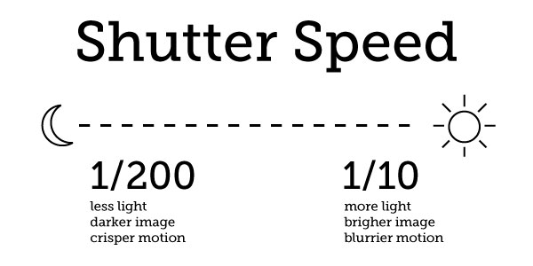
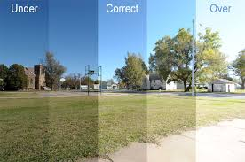
Parameters
Parameters
Exposure
How long do we want to count photons?
http://www.myphotoshopsite.com/tutorials/level_3/images/exposure_sample.jpg
https://cdn.tutsplus.com/photo/uploads/legacy/287_meterviewfinder/PerfectExposure-1.jpg
1

Slide 23
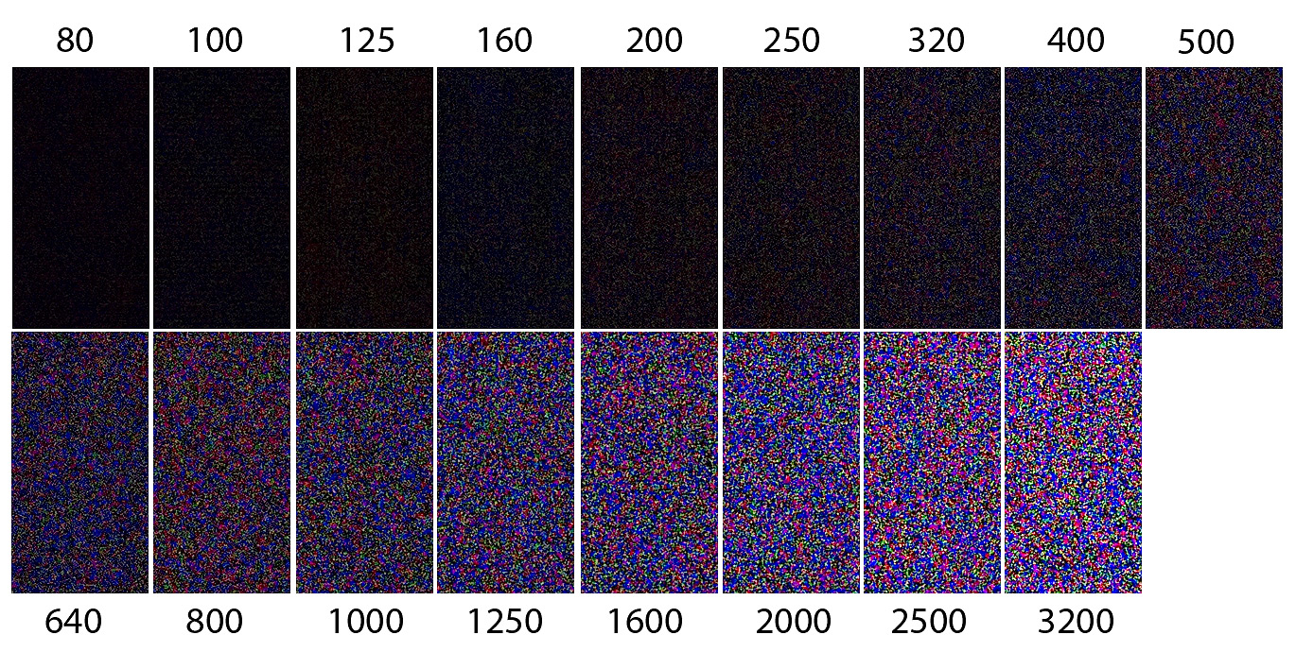
Parameters
Parameters
Gain (ISO in digital sensors)
Amount of amplification
Effect: More quantification & photon noise → Lower SNR!
https://blog.carlchapman.com/wp-content/uploads/2011/07/canon-g12-noise-shots-4EV.jpg
1

Slide 24
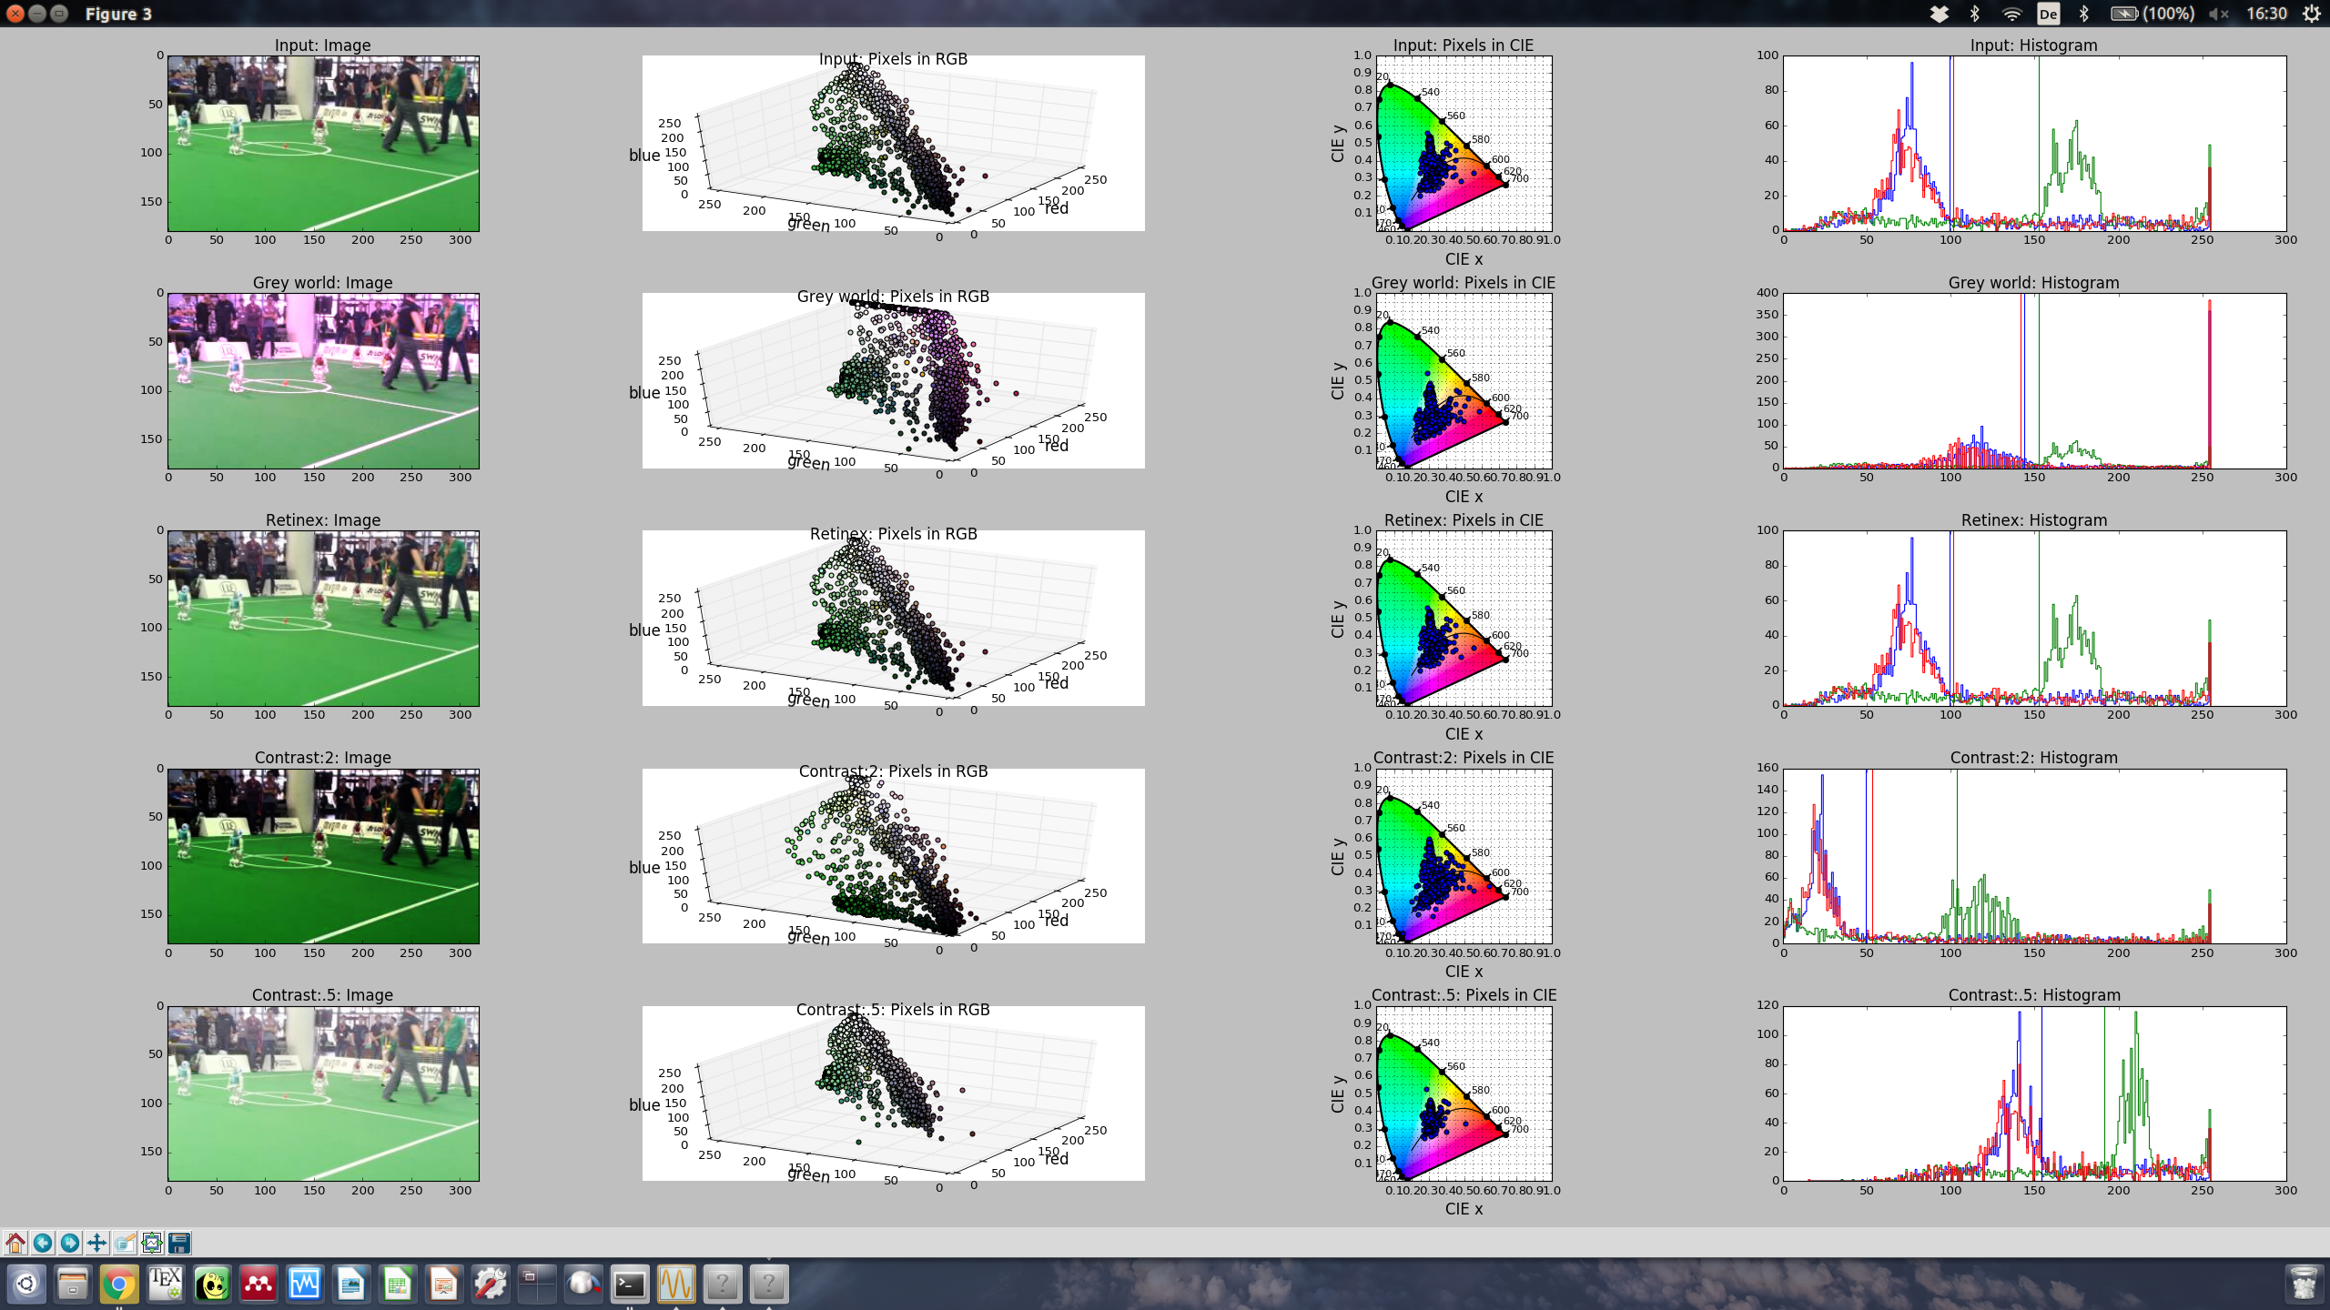
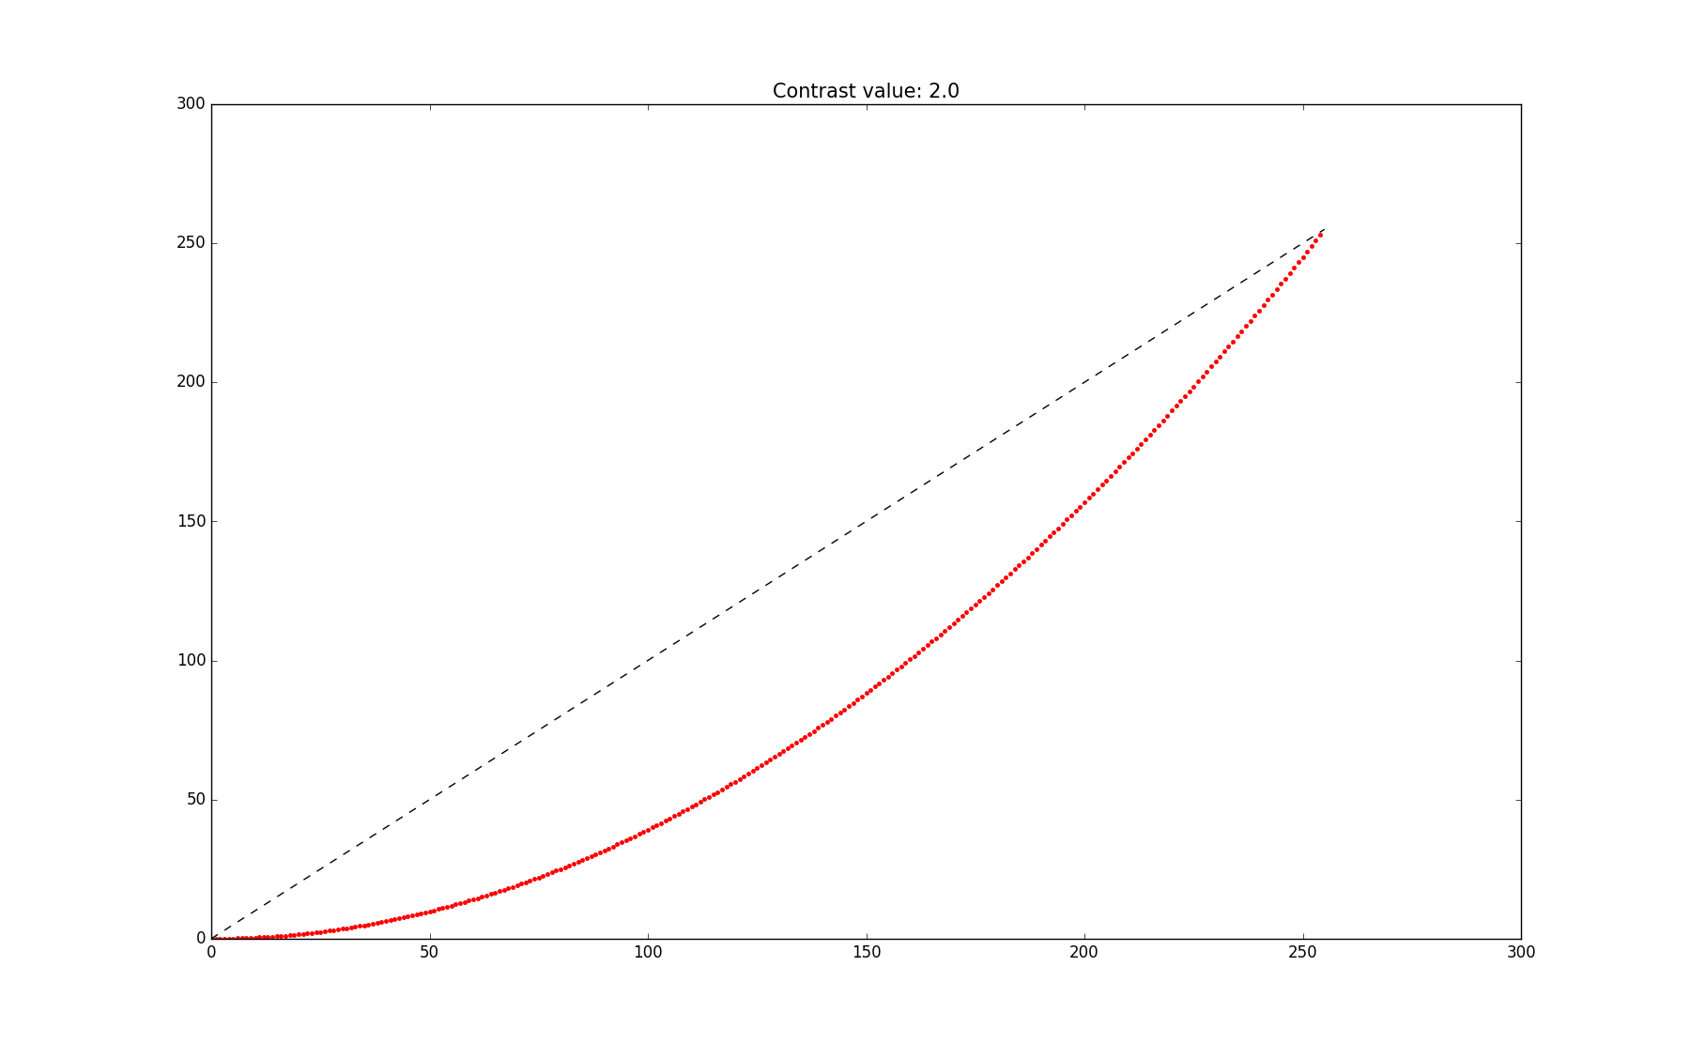
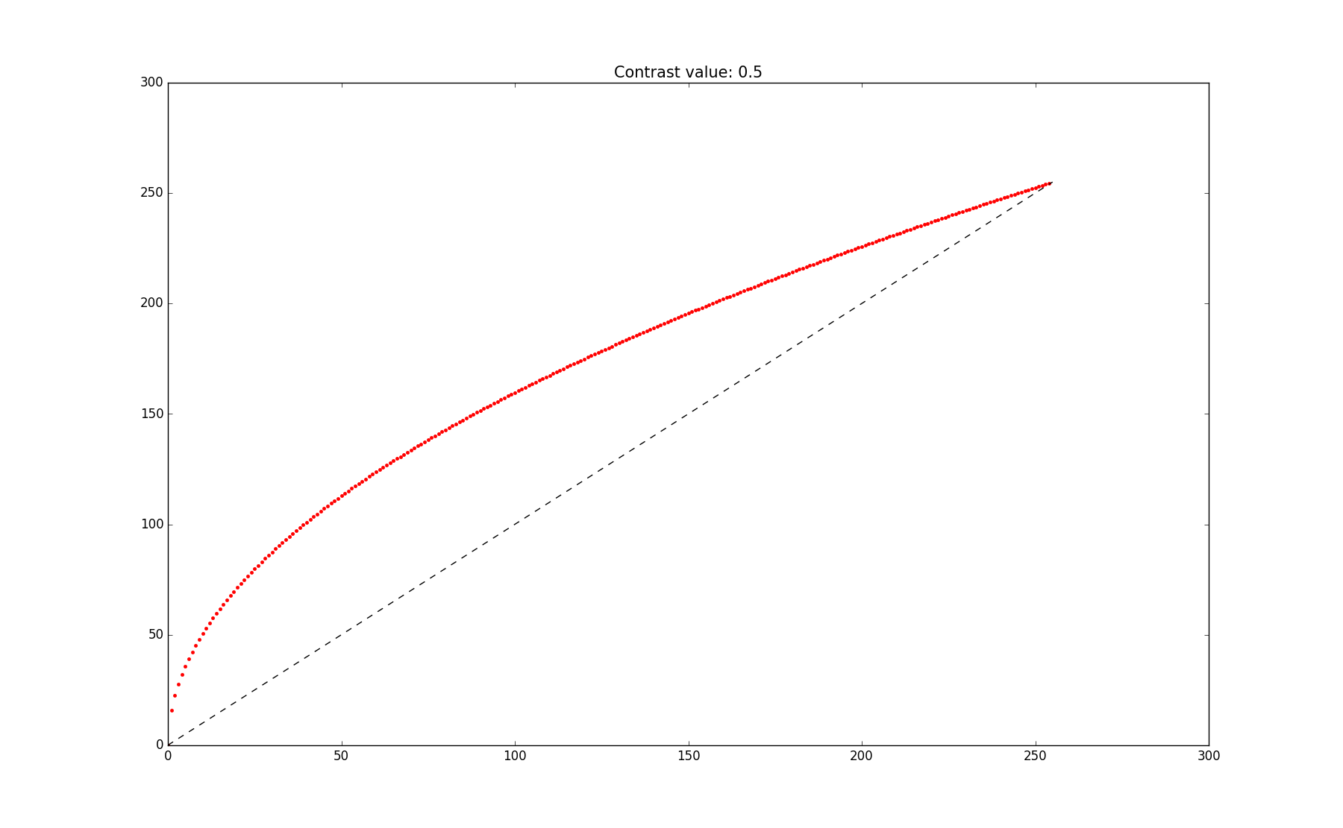
Parameters
Parameters
Contrast (nao: slope of curve at the end, could not find details about mapping function)
1

Slide 25
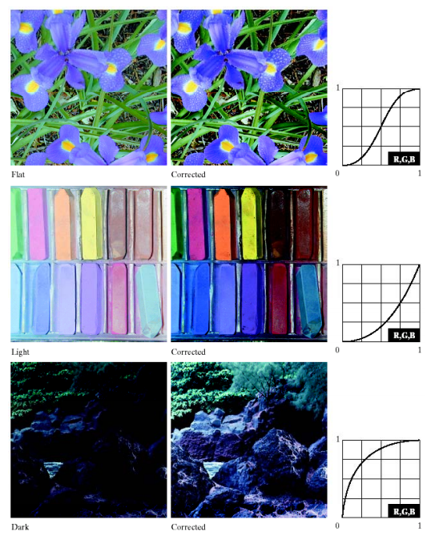
Parameters
Parameters
Contrast
http://eeweb.poly.edu/~yao/EL5123/lecture3_contrast_enhancement.pdf
1

Slide 26
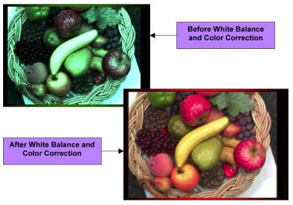
Parameters – White balance
Parameters - White balance
Why?
Remember: Bayer-Pattern to approximate the color response of the human visual system, which peaks in sensitivity in the green spectral region (approximately 550 nanometer wavelength). This approximation has to be translated back when displaying images → White balance (compute initial wavelength (color) that produced measurements)
http://www.siliconimaging.com/RGB%20Bayer.htm
1

Slide 27
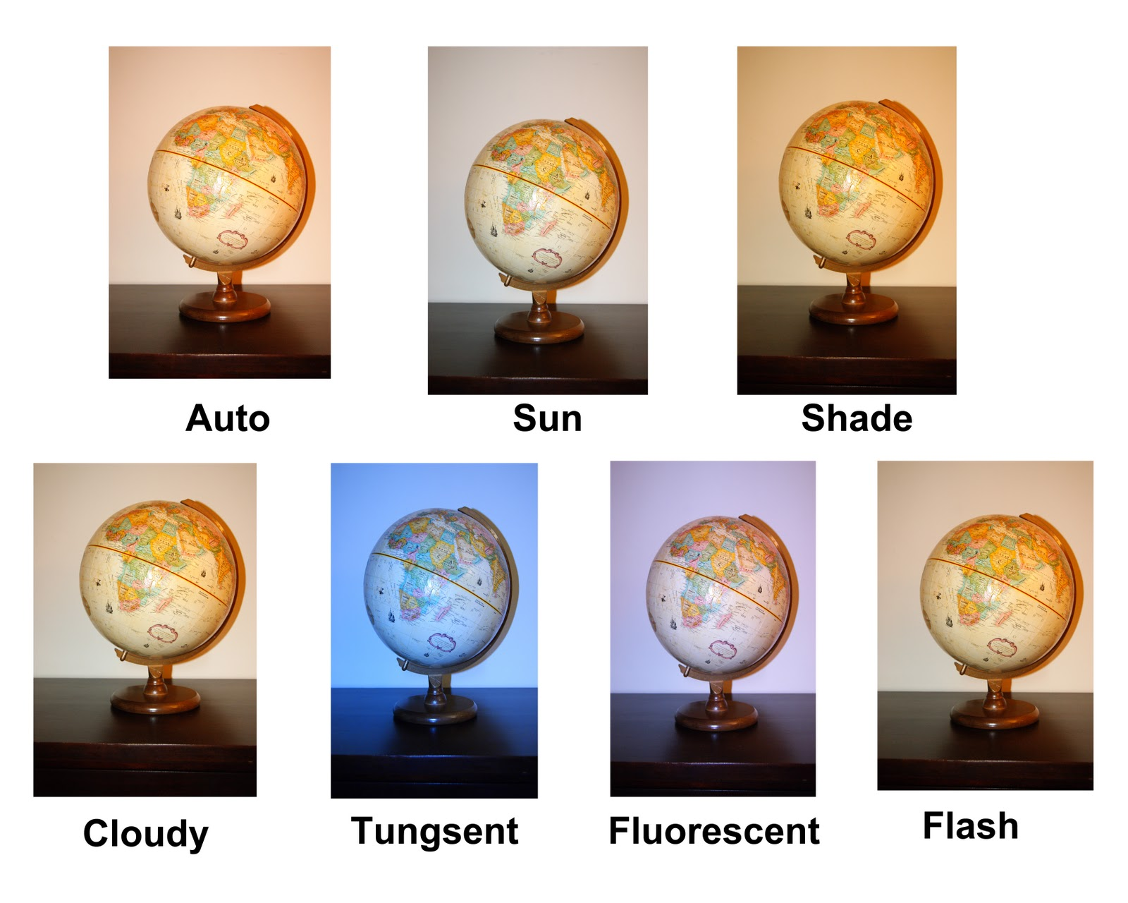
Parameters – White balance
Parameters - White balance
http://www.jrstjeanphotography.com/2011/01/end-of-white-balance.html
1

Slide 28
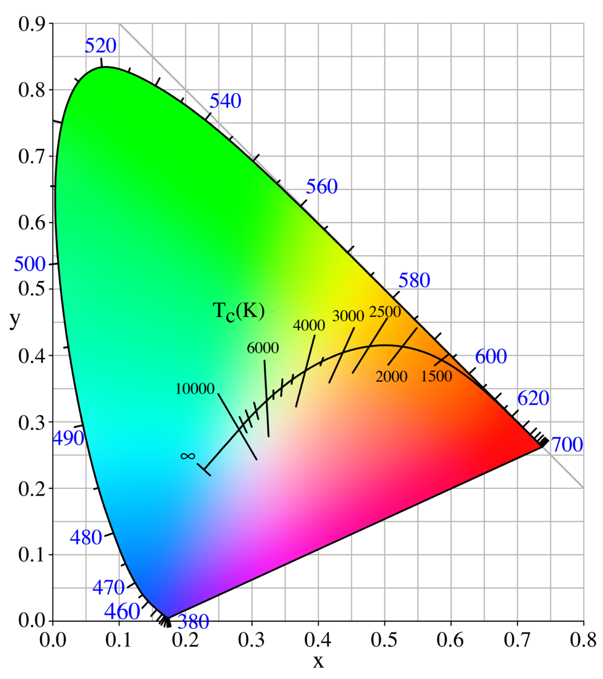

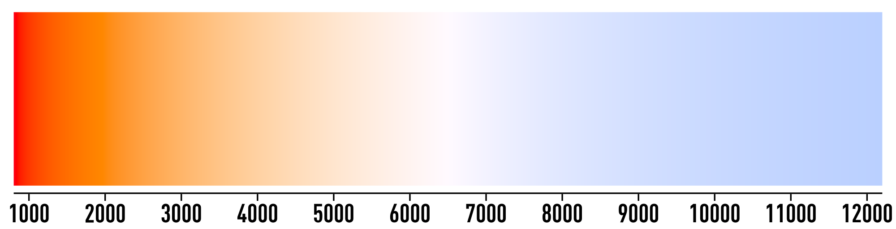
Parameters – White balance
Parameters - White balance
Why is white balance specified with Temperature in Kelvin?!
→ planckian blackbody radiators (good approximation to natural + artificial light sources)
Source: Tobi
https://en.wikipedia.org/wiki/Black-body_radiation
https://en.wikipedia.org/wiki/Black-body_radiation
1

Slide 29
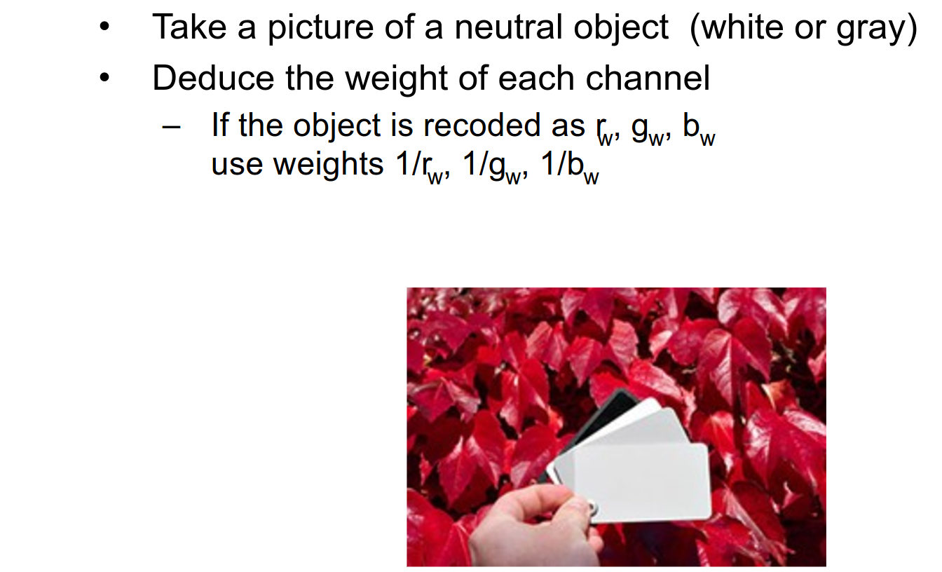
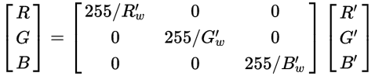
Parameters – White balance
Parameters - White balance
Approaches (image color correction or illuminant estimation + correction)
Scale R,G,B (or XYZ, or LMS, von Kries hypothesis, image color correction):
Assumed “white/neutral” pixel: [R’, G’, B’], scale each color channel individually

Slide 30
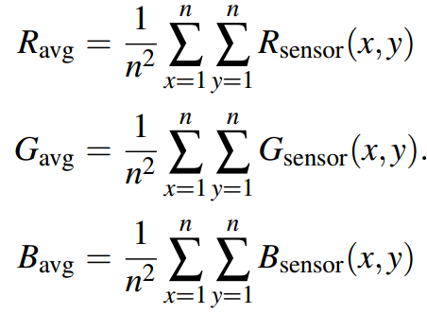
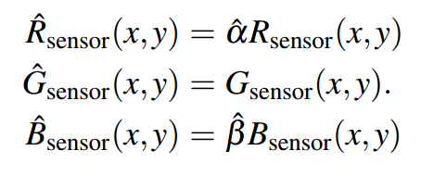
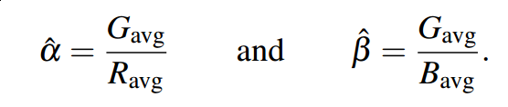
Parameters – White balance
Common selection of white/neutral → scale factors:
Grey world assumption (average reflectance of a scene is achromatic)
“[…] we can adjust a gain factor to two of the channels so that both their means are now equal to the reference channel, which is often taken to be green.”
“This gray world method is quite effective in practice, except in situations where
a certain color may dominate, [...]”
Very good general report on white balance and algorithms: https://courses.cs.washington.edu/courses/cse467/08au/labs/l5/whiteBalance.pdf

Slide 31
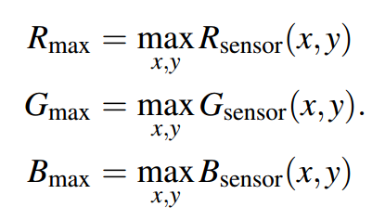
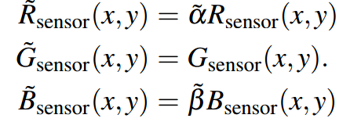
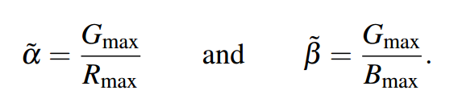
Parameters – White balance
Common selection of white/neutral → scale factors:
Retinex Theory (white patch)
perceived white is associated with the maximum cone signals (white world assumption)
brightest point in an image is often due to reflectance of a glossy surface,
which tends to reflect the actual color of the light source
attempts to equalize the maximum value of the three channels to produce a white patch
Very good general report on white balance and algorithms: https://courses.cs.washington.edu/courses/cse467/08au/labs/l5/whiteBalance.pdf

Slide 32
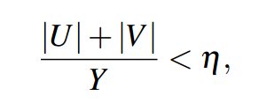
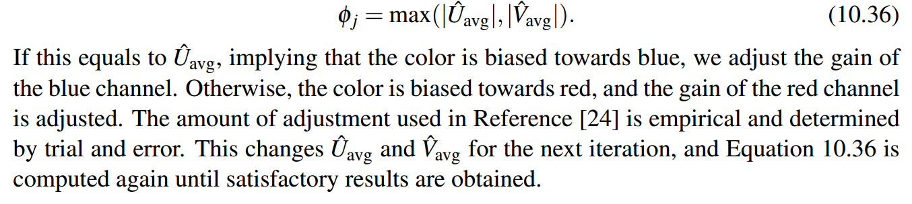
Parameters – White balance
Common selection of white/neutral → scale factors:
Iterative white-balancing
Problems of grey-world: heavily biased towards color-cast if scene is dominated by color
Problems of white-world: a few bright pixels might dominate calculations
Idea: transform image to YUV space, find pixels that satisfy a grey-condition (subset!)
Average the U,V values of these pixels, then:
Very good general report on white balance and algorithms: https://courses.cs.washington.edu/courses/cse467/08au/labs/l5/whiteBalance.pdf

Slide 33
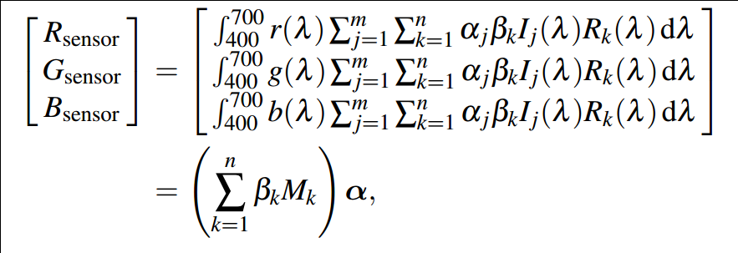
Parameters – White balance
Other methods:
Illuminant voting
Color by correlation
Gamut mapping
Bayesian formulation, Neural nets, combined strategies
Question: which method is used by Nao?
Very good general report on white balance and algorithms: https://courses.cs.washington.edu/courses/cse467/08au/labs/l5/whiteBalance.pdf

Slide 34
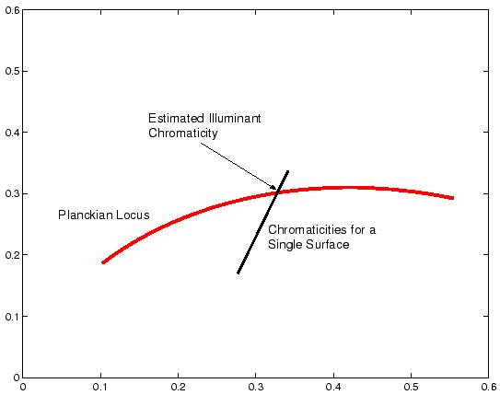
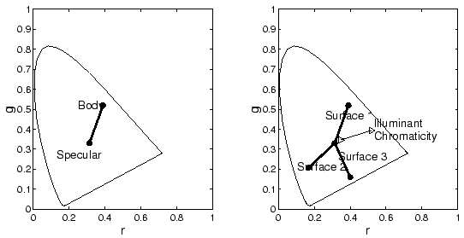
Parameters – Illuminant estimation
Illumination estimation (constrained)
Lee et. al:
Hsien-Che Lee. Method for computing scene-illuminant chromaticity from specular highlights.
In Glenn E. Healey and Steven A. Shafer and Lawrence B. Wolff, editor, Color, pages 340-347.
Jones and Bartlett, Boston, 1992.
http://www2.cmp.uea.ac.uk/Research/compvis/CGmainPhysicsBased.htm
1

Slide 35
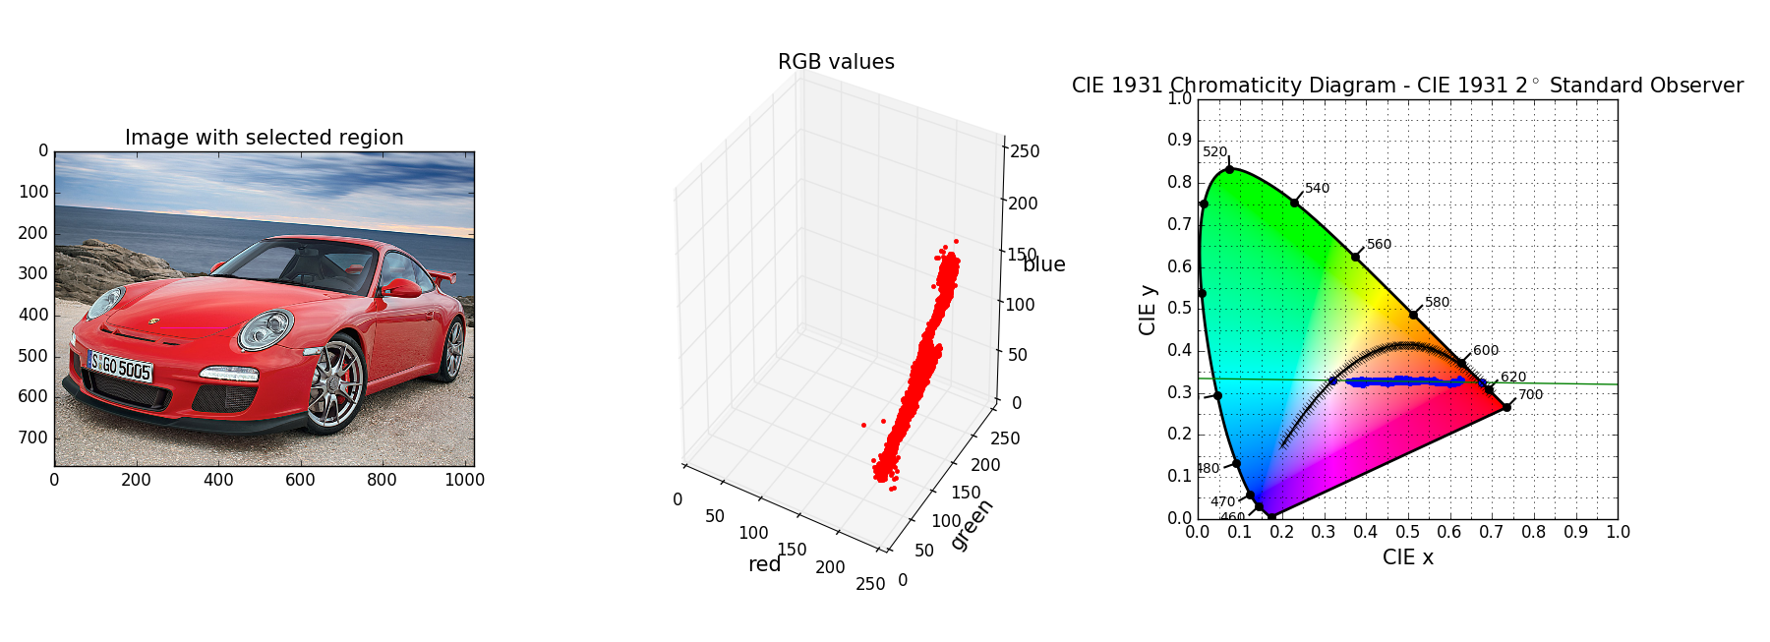
Parameters – Illuminant estimation
Illumination estimation
1

